Slide 1
https://galeracluster.com/
  What Is Galera Cluster?
  How to Set Up a Galera Cluster
  Implementing Load Balancing with HAProxy
  Operations
  Primary Component Recovery
  Resetting Quorum
  Crash Recovery
GALERA CLUSTER

Slide 2
GALERA CLUSTER
Galera Cluster is a system that allows multiple MySQL or MariaDB servers to operate as a single, highly available unit. Data is replicated across all servers, and any changes are applied in real-time to maintain consistency. This provides a fast and robust solution for database management.

Slide 3

Set Up Galera Cluster
INSTALLATION
HOSTS
ALLOW PORTS
sudo apt update
sudo apt install mariadb-server mariadb-client rsync galera-4
  mariadb-server: This is the database. It saves your data.
  mariadb-client: This is how you talk to the database using commands.
  rsync: This helps copy data from one server to another.
  galera-4: This lets many MariaDB servers work together like a team.
On all nodes (loadbalancer,node1, node2,..), you should add the IPs and names of all nodes and the load balancer in /etc/hosts:
192.168.155.181 node1
192.168.155.116 node2
192.168.155.22 loadbalancer
for check this Run:
ping node1
ping node 2
.......
On All Galera Nodes, allow these ports:
4567 cluster communication(talk each other)
4568 Incremental State Transfer (IST)
4444 State Snapshot Transfer (SST)
3306 MariaDB database port(like connect to mysql)
sudo ufw allow ‘port’/tcp
sudo ufw enable
in loadbalancer just allow 3306

Slide 4
Set Up Galera Cluster
START AND WSREP
in all node
sudo systemctl enable mariadb
in /etc/mysql/conf.d/galera.cnf add this:
binlog_format=ROW
default_storage_engine=InnoDB
innodb_autoinc_lock_mode=2
bind-address=0.0.0.0
wsrep_on=ON
wsrep_provider=/usr/lib/galera/libgalera_smm.so
wsrep_cluster_address="gcomm://ip_node1,ip_node2,..."
wsrep_cluster_name="galera_cluster"
wsrep_node_address="this node ip"
wsrep_node_name="this node name"
wsrep_sst_method=rsync //for sst method
Start the first node with:
galera_new_cluster → this node be primary
Start the other nodes with:
systemctl start mariadb
Confirm connection by checking cluster size:
SHOW STATUS LIKE 'wsrep_cluster_size';

Slide 5
HAPROXY
HAProxy sends your database requests to a working MariaDB server. If a server stops working, HAProxy just sends your requests to another one that is still good.
01
02
03
INSTALL HOSTS AND PORT
EDIT HAPROXY CONFIG:
USE
I have already set up the /etc/hosts files and opened the necessary ports on all nodes and the load balancer.
/etc/mysql/mariadb.conf.d/50-server.cnf → set bind-address to 0.0.0.0
on loadbalancer:
sudo apt update
sudo apt install haproxy
sudo systemctl enable haproxy
sudo systemctl start haproxy
on /etc/haproxy/haproxy.cnf
frontend mariadb_front
bind *:3306
default_backend galera_back
backend galera_back
balance leastconn
mode tcp
server node1 192.168.155.181:3306 check
server node2 192.168.155.116:3306 check
# add more nodes if needed
on every MariaDB server:
CREATE USER 'your_username'@'load_balancer_ip'
on loadbalancer:
sudo systemctl restart haproxy
now on all clients we access to loadbalancer with:
mysql -h <load_balancer_ip> -u <your_username>

Slide 6
SOME OPERATIONS
In a Galera Cluster, every server can read and write data — none of them is special or only for reading or writing.
  When you change data on one server, Galera quickly copies that change to all the other servers at almost the same time. This way, all servers have the same up-to-date data.
DDL means commands that create, change, or delete database tables.
In Galera, these commands must run on all nodes in the same order to keep data consistent.
The default method pauses other operations briefly to ensure safety.
  For big changes, special tools can apply updates without stopping the database
SHOW STATUS LIKE 'wsrep_cluster_size'; : Number of nodes currently in the Primary Component:
wsrep_local_state and wsrep_local_state_comment: The state of the current node
wsrep_cluster_status:
Shows cluster status: Primary means cluster is active and healthy.
wsrep_received
Number of transactions received from other nodes.
READ & WRITE
DDL
MONITORING

Slide 7

Recovering Primary Component
When no nodes are running, the gvwstate.dat file is empty. When the first node starts, it creates the file containing information like UUID (Cluster ID), View ID (who joined first), members list, Seqno (which grows as nodes join or leave), and bootstrap (set to 1 only once when galera_new_cluster runs; otherwise 0). If a node shuts down, its gvwstate.dat may reset or persist depending on how it stopped. When the first node stops, it updates the View ID of other nodes. This file helps Galera recover during network issues, and even if the network is lost, gvwstate.dat can remain and assist with quorum checks

Slide 8
Gvwstate.dat
On each MySQL node, run this command to get its unique identifier:SELECT UUID();
  This generates a UUID for each node.
  In the gvwstate.dat file, add all these UUIDs to the members list.
  This list represents all nodes in the cluster.
  For each node, record its own UUID as my_uuid in the file.
  Set bootstrap = 0 for all nodes (except when you bootstrap the cluster, then it is 1).
  Set the view_id to a chosen uuid
  Set the seqno. This number increases as nodes join or leave the cluster.

Slide 9
  GCASH keeps track of which nodes are working in the cluster.
  WriteSets are the changes to the database that nodes send to each other.
  IST helps a node catch up by sending only the changes it missed.
  GCASH makes sure only active nodes get the WriteSets, and IST helps nodes update quickly.

Slide 10
What Is Quorum?
  Quorum means most nodes are online and can talk to each other
  It helps protect your data from problems like split-brain
  If quorum is lost, the cluster stops on purpose to avoid corruption

Slide 11
Resetting the Quorum
Use when quorum is lost
  If only some of the nodes go down, it usually means those nodes had a local issue, like a network or hardware problem. But if all nodes go down, it's likely that something affected the entire cluster, such as a power outage or a broader system failure
Choose the best (most up-to-date) node
  chek with wsrep_last_committed
  /var/lib/mysql/grastate.dat
Bootstarp
  SET GLOBAL WSREP_PROVIDER_OPTIONS=’pc.bootstrap=YES’; this is ist
  galera_new_cluster this is sst

Slide 12
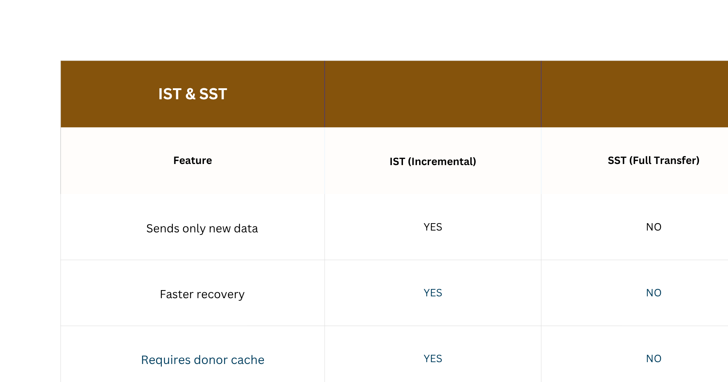

Slide 13
Crash Recovery
one or two node Gracefully Stopped
  If the last node stays up, it remains the primary and continues working. When the other nodes come back online, they can be updated using IST (if possible) or SST from this node. However, while the cluster is syncing, the last node may become a donor or temporarily unsynced. In this case, the load balancer might stop directing traffic to it until it's fully synced again.
All node Gracefully stopped
  State of the node is saved in /var/lib/mysql/grastate.dat.
  During recovery, the node with the highest seqno (last transaction number) is chosen to bootstrap the cluster using galera_new_cluster.
one node crashed
  Two nodes keep quorum
  The crashed node rejoins using IST or SST

Slide 14
Crash Recovery
Two node crashed
  One node left can’t continue alone
  Manual cluster restart is needed
  SET GLOBAL wsrep_provider_options=’pc.bootstrap=TRUE’;
All Nodes Crash
  in /var/lib/mysql/grastate.dat seqno = -1
  find seqno in mysqld --wsrep-recover
  /var/lib/mysql/grastate.dat → bootstrap=1
  galera_new_cluster

Slide 15
Crash Recovery
Split Brain
Split Brain happens when the nodes in a cluster lose network connection with each other.
Each part of the cluster thinks it is the main one and keeps working alone.
This can cause data problems, because different nodes make changes without knowing what the others are doing.

Slide 16
TRY SPLIT BRAIN
disconnect one node with other nodes
sudo iptables -A INPUT -s otherip -j DROP
sudo iptables -A OUTPUT -d otherip -j DROP,sudo iptables -A INPUT -p tcp --dport 3306 -j DROP
now this node is non-primary
in that node:SET GLOBAL wsrep_provider_options=’pc.bootstrap=TRUE’;
now we two cluster that are seprated.
01
02
Make Connections
sudo iptables -f
If you want the separated node to become the new cluster:
- Stop all other nodes.
- On the separated node, run `galera_new_cluster`.
If you want the separated node to rejoin an existing cluster instead:
- Delete the grastate file with `rm -f /var/lib/mysql/grastate.dat`.
- Then start MySQL on that node

